Slide 1
DM & Anesthesia
Biruk T.

Slide 2
Liver is the 1° source of endogenous glucose production through
Glycogenolysis
Gluconeogenesis
Meal →↑plasma glucose→↑insulin secretion→↑glucose utilization
After 2-4 hours of a meal →glucose utilization > glucose production
Leads to transition from exogenous glucose → endogenous production
Endogenous glucose production maintain normal plasma glucose

Slide 3
70-80% of liver glucose is metabolized by insulin insensitive tissues
Brain
GI tract
Red blood cells
↓insulin secretion is important for maintenance of normal plasma glucose concentration

Slide 4
Hyperglycemia producing hormones
Glucagon
Growth hormone
Epinephrine
Cortisol are counter regulatory systems
Support glucose production
Glucagon stimulate glycogenolysis, gluconeogenesis & inhibit glycolysis
DM inadequate supply of insulin and/or inadequate tissue response to insulin

Slide 5
Classification
Type 1A DM: autoimmune destruction of ß cells in pancreatic islets
Resulting in complete absence or minimal circulating insulin
Type 1B: rare disease of absolute insulin deficiency
Not immune mediated
2. Type 2 DM: defects in insulin receptors & post receptor signaling pathway
3. Gestational DM: diagnosed in the 2nd & 3rd trimester
It is not overt DM prior to gestation

Slide 6
Classification
4. Specific types of DM to other causes
Monozygotic diabetes syndrome
Neonatal DM
Maturity onset DM of the young
Diseases of the exocrine pancreas: cystic fibrosis, pancreatitis
Drugs or chemical induced DM : glucocorticoids, Rx of HIV/AIDS,organ transplantation

Slide 7
Sign & symptoms type I DM
5%-10% of DM of all cases of DM
Type 1 T- cell mediated autoimmune destruction of ß cells in the panc
Unknown causes – enterovirus, dietary protein, drugs & chemicals initiate the autoimmune response
80-90% of ß cell function is lost before hyperglycemia
Hyperglycemia, fatigue, weight loss,polyuria,polydipsia, blurring of vision & signs of IV depletion
Ketoacidosis – severe insulin deficiency & unrestrained lipolysis

Slide 8
Type 2
90% of all cases of DM, overweight, middle age & older
Relative ß cell insufficiency & insulin resistance
Insulin insensitivity →↑pancreatic secretion(to maintain normal PG)
As disease progress→↓pancreatic cell function→insulin levels are unable to compensate→hyperglycemia

Slide 9
3 important defects in type 2
↑ rate of hepatic glucose release
Impaired basal & stimulated insulin secretion
Inefficient use of glucose by peripheral tissue (insulin resistance)
Obese patients- compensatory hyper insulinemia
Desensitized target organs
↓ insulin response

Slide 10
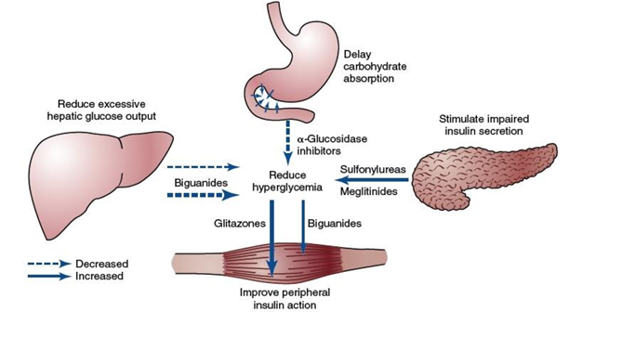

Slide 11
Metabolic syndrome, or insulin-resistance syndrome
Fasting plasma glucose level ≥ 110 mg/dL
Abdominal obesity (waist girth > 40 inches in men, >35 inches in women)
Serum triglyceride level ≥ 150 mg/dL
Serum high-density lipoprotein cholesterol level < 40 mg/dL in men,
< 50 mg/dl in women
5. Blood pressure ≥ 130/85 mm Hg
At least three of the above

Slide 12
Diagnosis
The American Diabetes Association (ADA) has established diagnostic criteria for diabetes mellitus:
❖ Categories of increased risk for diabetes (prediabetes)
✓ FPG 100 mg/dL - 125 mg/dL (IFG) OR
✓ 2-h PG during 75-g OGTT 140 mg/dL to 199 mg/dL (IGT) OR
✓ A1C 5.7–6.4%

Slide 13
Criteria for the diagnosis of diabetes
✓ FPG ≥ 126 mg/dL (7.0 mmol/L). Fasting is defined as no caloric intake for at least 8 h. OR
✓ 2-h PG ≥ 200mg/dL (11.1mmol/L) during OGTT.. OR
✓ A1C ≥ 6.5% (48 mmol/mol). OR
✓ In a patient with classic symptoms of hyperglycemia or hyperglycemic crisis, a random plasma glucose ≥ 200 mg/dL (11.1 mmol/L).
Notes:
2.The test should be performed as described by the WHO, using a glucose load containing the equivalent of 75-g anhydrous glucose dissolved in water

Slide 14
Hemoglobin A1C
The HbA1c test provides a valuable measure of long-term glycemic control
Hemoglobin is non-enzymatically glycosylated by glucose, which freely crosses red blood cell membranes.
The percentage of hemoglobin molecules participating in this reaction is proportional to the average plasma glucose concentration during the preceding 60–90 days.
The normal range for HbA1c is 4%–6%
Increased risk of microvascular and macrovascular disease begins when the HbA1c proportion is 6.5% or higher

Slide 15
TREATMENT
The cornerstones of treatment for type 2 diabetes are
Dietary adjustments along with
Weight loss
Exercise therapy
Oral antidiabetic drugs

Slide 16
Oral Antidiabetic Drugs
❖ The four major classes of oral antidiabetic medications are
The secretagogues (sulfonylureas, meglitinides), which increase insulin availability;
The biguanides (metformin), which suppress excessive hepatic glucose release;
The thiazolidinediones or glitazones (rosiglitazone, pioglitazone), which improve insulin sensitivity;
The α-glucosidase inhibitors (acarbose, miglitol), which delay GI glucose absorption

Slide 17
These agents are used to maintain glucose control, which is defined as a
✓ Fasting glucose level of 90–130 mg/dL,
✓ Peak postprandial glucose level below 180 mg/dL, and
✓ HbA1c level below 7% in the initial stages of the disease

Slide 18
sulfonylureas
are usually the initial pharmacologic treatment for type 2 diabetes mellitus
They act by stimulating insulin secretion from pancreatic beta cells;
✓ They can also enhance insulin-stimulated peripheral tissue utilization of glucose
✓ The second-generation agents (glyburide, glipizide, glimepiride) are more potent and have fewer side effects than their predecessors

Slide 19
Another class of insulin secretagogues act as GLP-1 (glucagon-like peptide 1) agonists or enhance endogenous GLP-1 activity in the gut
Exenatide and liraglutide are examples and have been approved for treatment for type 2 diabetes
✓ These agents (incretins) increase glucose-stimulated insulin secretion ✓ Suppress glucagon, and
✓ Slow gastric emptying
Dipeptidyl peptidase-4 inhibitors (saxagliptin, sitagliptin, vildagliptin) inhibit the degradation of native GLP-1 and thus enhance glucose-stimulated insulin secretion

Slide 20
The biguanides
Decrease hepatic gluconeogenesis and
To a lesser degree enhance utilization of glucose by skeletal muscle and adipose tissue by increasing glucose transport across cell membranes
Lowering glucose levels
They decrease plasma levels of triglycerides
Low-density lipoprotein cholesterol
Reduce postprandial hyperlipidemia and plasma free fatty acids

Slide 21
The risk of hypoglycemia is less than that with the sulfonylureas
Lactic acidosis is a rare but serious side effect of the biguanides
The risk is particularly high in patients with renal insufficiency.
It is much less common with metformin than with its predecessor phenformin.

Slide 22
Thiazolidinediones or glitazones
Are insulin sensetizers
That decrease insulin resistance by binding to peroxisome proliferator–activated receptors located in skeletal muscle, liver, and adipose tissue.
These drugs influence the expression of genes encoding proteins for glucose and lipid metabolism, endothelial function, and atherogenesis;
As a result, they may influence diabetic dyslipidemia in addition to hyperglycemia

Slide 23
The α-glucosidase inhibitors
inhibit α-glucosidase enzymes in the brush border of enterocytes in the proximal small intestine,
which results in a delay in intraluminal production and subsequent absorption of glucose.
They are administered before a main meal to ensure their presence at the site of action
In most patients, therapy is initiated with a sulfonylurea or biguanide and titrated to achieve fasting and peak postprandial glucose levels recommended by the ADA

Slide 24
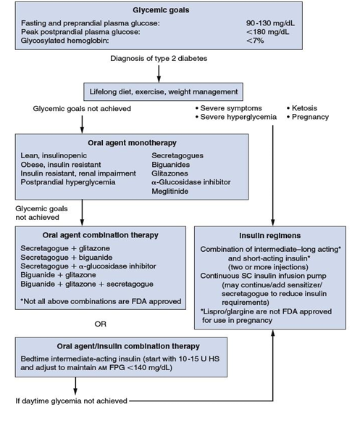

Slide 25
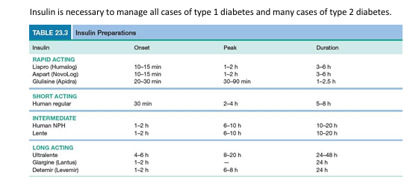

Slide 26
COMPLICATIONS
➢ Acute complications:
✓ Diabetic ketoacidosis (DKA)
✓ Hyperosmolar nonketotic coma (HONC)
✓ Hypoglycemia (Blood glucose ≤ 50 mg/dl).

Slide 27
➢ Chronic complications:
✓ Microvascular: o Eye disease:
▪ Retinopathy
▪ Macular edema.
Neuropathy:
▪ Sensory and motor neuropathy (“stocking-glove” distribution), foot fractures (Charcot joint)
▪ Autonomic neuropathy.
Nephropathy

Slide 28
Macrovascular:
Coronary artery disease
Cerebrovascular accidents
Peripheral vascular disease

Slide 29
Cardiac complications: The diabetic patient has an increased risk of:
Coronary artery disease
✓ Diabetic patients > 65 years of age have significant symptomatic/asymptomatic coronary artery disease.
Silent ischemia may be present because of diabetic autonomic neuropathy
Hypertension
Peripheral arterial disease

Slide 30
Systolic and diastolic dysfunction, related to:
✓ Coronary artery disease
✓ Hypertension
✓ Left ventricular hypertrophy
✓ Endothelial dysfunction
✓ Obesity
✓ Autonomic neuropathy

Slide 31
Other complications
Cataract, glaucoma
Gastrointestinal:
✓ Gastroparesis, constipation
✓ Diarrhea
Genitourinary:
✓ Uropathy
✓ Erectile dysfunction
Dermatological
Infection

Slide 32
HOW TO ASSESS FOR AUTONOMIC NEUROPATHY
Overt signs and symptoms of autonomic disease are as follows:
Cardiovascular
✓ Resting tachycardia
✓ Exercise intolerance
✓ Orthostatic hypotension
✓ Silent myocardial ischemia.

Slide 33
GI
✓ Esophageal dysmotility (dysphagia)
✓ Gastroparesis
✓ Constipation
✓ Diarrhea
✓ Fecal incontinence

Slide 34
Genitourinary
✓ Neurogenic bladder (diabetic cystopathy)
✓ Erectile dysfunction
✓ Retrograde ejaculation
✓ Female sexual dysfunction (e.g. loss of vaginal lubrication).
Metabolic
✓ Hypoglycemia unawareness
✓ Hypoglycemia-associated autonomic failure

Slide 35
Sudomotor
✓ Anhidrosis
✓ Heat intolerance
✓ Gustatory sweating
✓ Dry skin.
Pupillary
✓ Pupilometer function impairment (e.g. decreased diameter of dark adapted pupil)
✓ Argyll-Robertson pupil.

Slide 36
TESTS FOR DIABETIC AUTONOMIC NEUROPATHY
✓ Early stage: Abnormality of heart rate response during deep breathing alone
✓ Intermediate stage: An abnormality of Valsalva response
✓ Late stage: The presence of postural hypotension

Slide 37
The tests for parasympathetic control
➢ Heart rate variability (HRV) in response to:
Deep breathing
2. Standing
3. Valsalva maneuver.
The tests for sympathetic control
➢ Blood pressure response to:
Standing or passive tilting
Sustained handgrip
Response to the Valsalva maneuver

Slide 38
Response to the Valsalva maneuver
In the standard Valsalva maneuver, the supine patient, connected to an ECG monitor, forcibly exhales for 15 s against a fixed resistance (40 mmHg) with an open glottis.
This results in a sudden transient increase in intrathoracic and intra abdominal pressures, with a characteristic hemodynamic response

Slide 39
Phase I: Transient rise in blood pressure and a fall in heart rate due to compression of the aorta and propulsion of blood into the peripheral circulation.
Hemodynamic changes are due to mechanical factors
B. Phase II: Initial fall in BP followed by the recovery of BP later in the phase
The BP changes are accompanied by an increase in HR
There is a fall in cardiac output due to decreased venous return which causes reflex tachycardia and peripheral resistance

Slide 40
C. Phase III: Drop in BP & rise in HR when expiration stopped
D. Phase IV: Overshoot of BP above the baseline value due to residual vasoconstriction in a setting of a now normal venous return and cardiac output.
There is a reflex bradycardia

Slide 41
The Valsalva ratio is calculated from the ECG waveform by dividing the longest R-R interval after the maneuver (in phase IV) to the shortest R-R interval during the maneuver.
A Valsalva ratio < 1.2 is abnormal

Slide 42
HRV (Heart Rate Variability)
➢ Respiratory sinus arrhythmia (RSA) is a normal phenomenon due to vagal input to sinus node during expiration causing cardio deceleration.
➢ Autonomic neuropathy decreases the HRV (difference in between maximum and minimum heart rate during the respiratory cycle)
➢ A clinical but less accurate method is to ask the patient to breathe quietly and deeply at a rate of six breaths per minute (at this rate there is maximum variation in heart rate)
✓ Normal variability > 15 beats /min
✓ Abnormal result < 10 beats /min

Slide 43
Aging is associated with decreased RSA due to decreased vagal tone and decreased beta receptor responsiveness and the criteria may not apply to patients above 60 years of age

Slide 44
Response to standing up (30: 15 ratio)
➢ There is a rapid increase in heart rate in response to standing that is maximal at approximately the 15th beat after standing.
➢ This is followed by a relative bradycardia that is maximal at approximately the 30th beat after standing.
➢ The heart rate should increase by 10%.
30:15 ratio is measured as the longest R-R interval during beats 20–40 divided by the shortest R-R interval during beats 5–25.

Slide 45
In patients with DAN, there is only a gradual increase in heart rate.
A. 30:15 ratio >1.04 is normal
B. 1.01 – 1.03 is borderline
C. < 1.01 is abnorma

Slide 46
Orthostatic hypotension:
➢ It is defined as a fall in BP > 30 mm Hg for systolic or >10 mm Hg for diastolic BP in response to postural change, from supine to standing.
➢ Normally, BP is rapidly corrected by baroreflex-mediated peripheral vasoconstriction and tachycardia and the fall in SBP is
✓ < 10 mm Hg- Normal.
✓ A drop by 11–29 mm Hg is borderline
✓ A drop > 30 mm Hg is significant

Slide 47
Sustained hand grip
➢ Sustained muscle contraction causes a rise in systolic and diastolic blood pressure and heart rate
➢ Exercising muscle stimulates a reflex arc resulting in increased cardiac output and heart rate
➢ As the peripheral vascular resistance is maintained the diastolic pressure rises by > 16 mm Hg
➢ A response of < 10 mm Hg is considered abnormal

Slide 48
Gastroparesis: The finding of retained food in the stomach after an 8–12 h fast in the absence of obstruction is diagnostic of gastroparesis.
Management of DAN: Control of blood sugar levels, ACE inhibitors and b-blockers have been tried for control of the condition

Slide 49
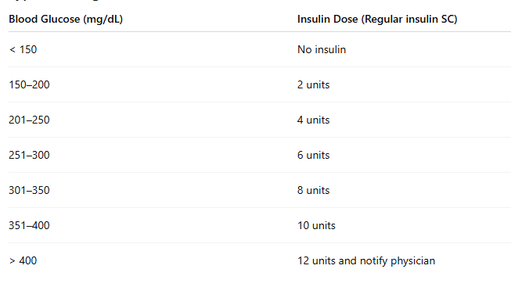
Sliding scale

Slide 50
PREOPERATIVE EVALUATION:
History:
➢ Central nervous system:
✓ Peripheral neuropathy (glove and stocking neuropathy)
✓ Headache, syncope
✓ TIA/stroke
➢ Cardiovascular:
✓ MI: Increased chances if erectile dysfunction present
✓ Silent MI: Increased chances if autonomic neuropathy
✓ Hypertension
✓ Congestive cardiac failure: Especially if poor glycemic control
✓ Dyspnea on exertion/reduced exercise tolerance

Slide 51
➢ Respiratory:
✓ Frequent infections
✓ Reduced VC, FVC, FEV, DLCO.
➢ Gastrointestinal:
✓ Gastroparesis due to ganglion cell damage
✓ Postprandial vomiting, early satiety
✓ Delayed gastric emptying.
➢ Genitourinary:
✓ Erectile dysfunction
✓ Renal failure especially if age > 55 years and diabetes & hypertension coexist.
➢ Medication history, history of anesthetic exposure
➢ Episodes of hypoglycemia/hyperglycemia

Slide 52
Physical examination
➢ Document vitals, orthostatic vital signs and skin breakdown points ➢ Sensory examination
➢ Airway examination:
➢ Stiff joint syndrome:
✓ Seen in poorly controlled DM
✓ Reduced mobility of cervical, atlantooccipital and TM joint occurs.
➢ Prayer sign: inability to approximate palmar surface of interphalangeal joints

Slide 53
Palm print sign:
✓ Alteration in palm print when it is taken on paper
✓ Indicates interphalangeal joint stiffness.
➢ Fundoscopy for retinopathy
➢ Tests for autonomic dysfunction
➢ Back for edema and infection: Difficult to perform subarachnoid block

Slide 54
Investigation
➢ Routine blood: Hb, TC, DC, ESR
➢ Renal function tests
➢ Preoperative FBS < 110 mg% in non-critically ill patients: ACE recommendations
➢ ECG, treadmill test for silent MI
➢ Chest X-ray: Cardiomegaly
➢ Pulmonary function tests

Slide 55
Investigation
➢ Glycated hemoglobin:
◼ Called HbA1c
◼ Best evidence of glucose control over the last 1–2 months
◼ Level < 2% recommended by ADA
◼ Microalbuminuria 29 mg/day with HbA1c 8.1% predicts 80% risk of CRF
◼ HbA1c 8.5–9% predicts increased chances of retinopathy.

Slide 56
CHOICE OF ANESTHETIC TECHNIQUE:
Regional Anesthesia : Technique of choice where applicable:
➢ Advantages:
◼ Avoids aspiration
◼ Better if difficult airway
◼ Patient is awake: Easy to recognize hypoglycemia
◼ Reduced incidence of DVT
◼ Reduced stress response to surgery
◼ Good postoperative analgesia
◼ Reduced chances of pulmonary infection.

Slide 57
Disadvantages:
◼ Exaggerated hypotension especially if autonomic neuropathy present ◼ Increased risk of epidural abscess
◼ Caution if pre-existing neuropathy
◼ Increased risk of nerve injury.

Slide 58
➢ Guidelines:
◼ Local anesthetic requirement is lower
◼ Combination of LA with adrenaline may increase risk of ischemic or edematous nerve injury
◼ Bradycardia may be unresponsive to atropine
◼ Isoprenaline/1:10,000 adrenaline used in such cases
◼ Chart pre-existing nerve damage as increased chance of nerve injury ◼ Technique: May be difficult if edema is present

Slide 59
➢ Contraindications:
◼ Autonomic neuropathy
◼ Infections

Slide 60
General Anesthesia
➢ Advantages:
◼ Better cardiovascular stability
◼ Airway is protected from silent aspiration.
➢ Disadvantages:
◼ Difficult intubation
◼ Difficult to recognize hypoglycemia
◼ Altered elimination of drugs due to renal involvement
◼ Increased stress response

Slide 61
PREOPERATIVE EVALUATION
Emphasize the cardiovascular, renal, neurologic, and musculoskeletal systems
Silent ischemia is possible if autonomic neuropathy is present, and
stress testing should be considered in patients with multiple cardiac risk factors and poor or indeterminate exercise tolerance
For renal disease, control of hypertension is important
Preservation of renal blood flow are also essential

Slide 62
Autonomic neuropathy predisposes to perioperative dysrhythmias & intraoperative hypotension
loss of compensatory sympathetic responses interferes with detection and treatment of hemodynamic insults
Limited joint mobility caused by non-enzymatic glycosylation of proteins and abnormal cross-linking of collagen
Gastroparesis may increase the risk of aspiration, regardless of nothing-by-mouth status
Oral hypoglycemics should be discontinued 24–48 hours preoperatively

Slide 63
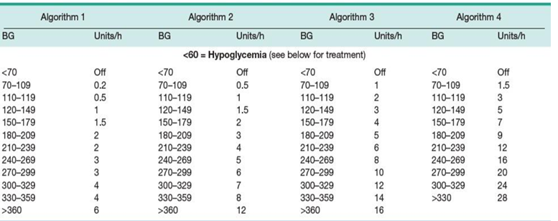
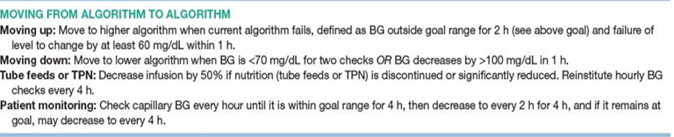

Slide 64
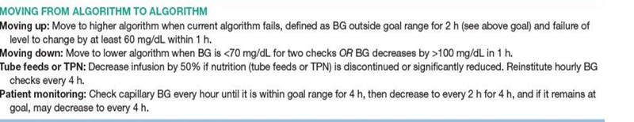
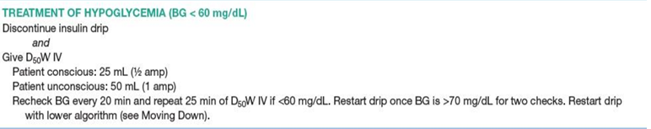

Slide 65
It is advised that sulfonylureas be avoided during the entire perioperative period
They block the myocardial potassium adenosine triphosphate (ATP) channels responsible for ischemia- and anesthetic-induced preconditioning
Ideally a continuous infusion of insulin should be initiated at least 2 hours before surgery.
Intraoperative serum glucose levels should be maintained between 120 and 180 mg/dL.
Levels above 200 mg/dL are likely to cause glycosuria and dehydration and to inhibit wound healing

Slide 66
Higher insulin requirement
Insulin infusion requirements are higher for patients undergoing
Coronary artery bypass graft surgery
Patients receiving steroids
Patients with severe infection
Patients receiving hyperalimentation
Vasopressor infusions

Slide 67
Insulin infusion
An insulin infusion should be accompanied by an infusion of 5% dextrose in half-normal saline
20 mEq KCl at 100–150 mL/h to provide enough carbohydrate (at least 150 g/day) to inhibit hepatic glucose production and protein catabolism
Serum glucose levels should be monitored at least every hour

Slide 68
Glucose measurement
Glucose determination is preferentially made using venous plasma or serum samples
Arterial and capillary blood yields glucose values approximately 7% higher than those for venous blood
Whole-blood determinations are usually 15% lower than plasma or serum values
Urine glucose monitoring is not reliable

Slide 69
Avoidance of hypoglycemia is especially critical
Recognition of hypoglycemia may be delayed in patients
Under anesthesia
Sedatives
Analgesics
ß-blockers
Sympatholytic
Autonomic neuropathy

Slide 70
During hypoglycemia -administration of 50 mL of 50% dextrose in water-increases the glucose level 100 mg/dL or 2 mg/dL/mL.

Slide 71
Postoperative management
Postoperative management of diabetic patients requires meticulous monitoring of insulin requirements
➢ Hyperglycemia has been associated with poor outcomes in postoperative and critically ill patients
➢ The risks of hypoglycemia must also be considered
➢ Currently the ADA recommends that glucose levels be maintained between 140 and 180 mg/dL in critically ill patients and that
Insulin treatment be initiated if serum glucose levels exceed 180 mg/dL

Slide 72
Drug/Class | Effect on Glucose & Endocrine Response
Ketamine | May cause significant hyperglycemia
Etomidate | Blocks adrenal steroidogenesis → ↓ cortisol synthesis; decreases hyperglycemic response to surgery
Propofol | Effect on insulin secretion unclear; in diabetics: reduced ability to clear lipids
Volatile agents (Halothane, Enflurane, Isoflurane, Sevoflurane) | Inhibit insulin response to glucose (dose-dependent, reversible)
Benzodiazepines | High doses: ↓ ACTH & cortisol; ↓ sympathetic stimulation; ↑ GH secretion → ↓ glycemic response; minimal effect in usual sedative doses (e.g., midazolam)
Opioids | High-dose: metabolic stability; but midazolam + fentanyl may cause hyperglycemia (↓ glucose clearance)
Ganglion-blocking agents | Block sympathetically mediated hepatic gluconeogenesis → may cause hypoglycemia
β-blockers | Associated with slower recovery from hypoglycemia

